Slide 1





Organizers
Sponsors
X
TRACK#5 : HUMAN FACE RECOGNITION
BY USING COMPUTER VISION
TEAM : RANKER
TEAM LEADER : AYUSHI AGARWAL

Slide 2


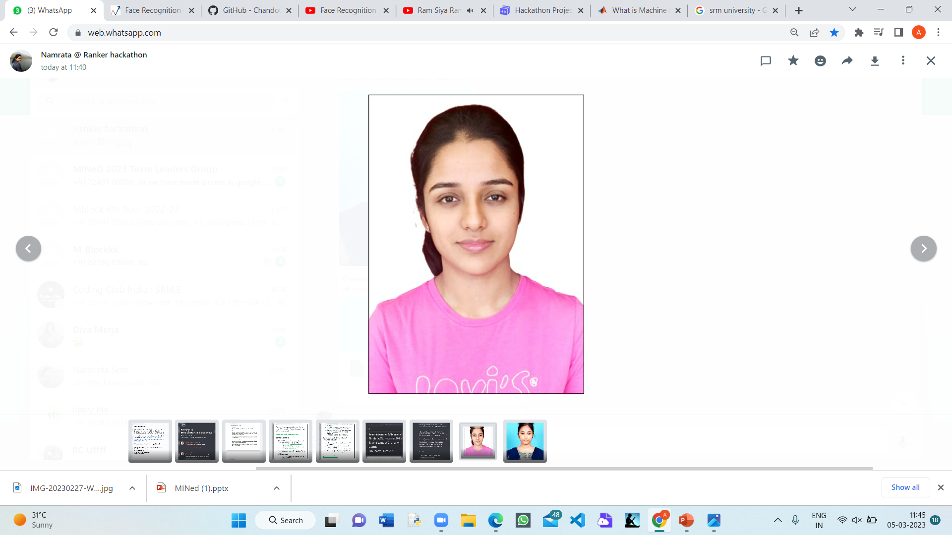
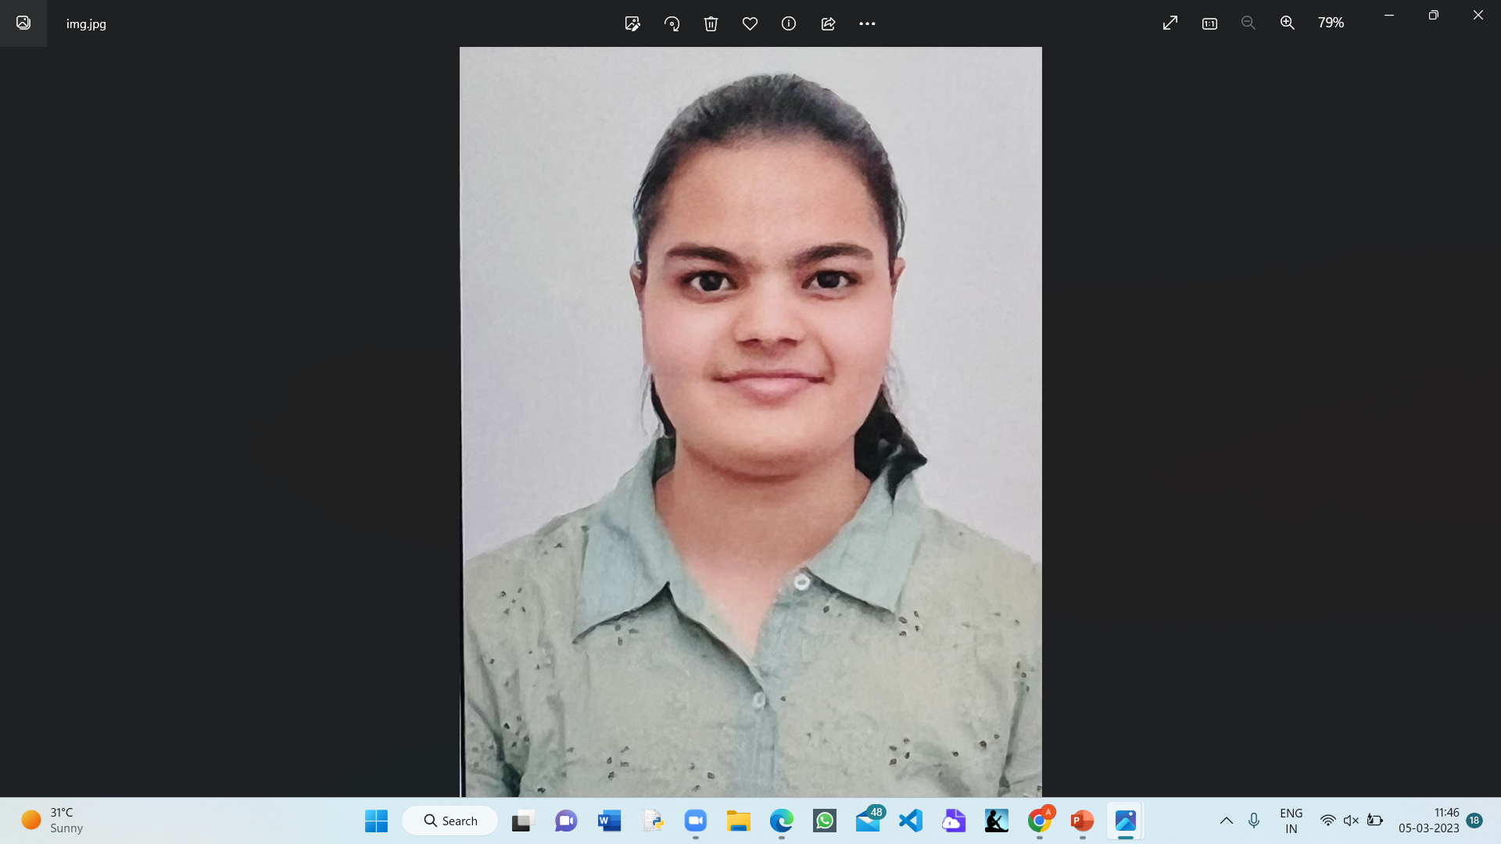
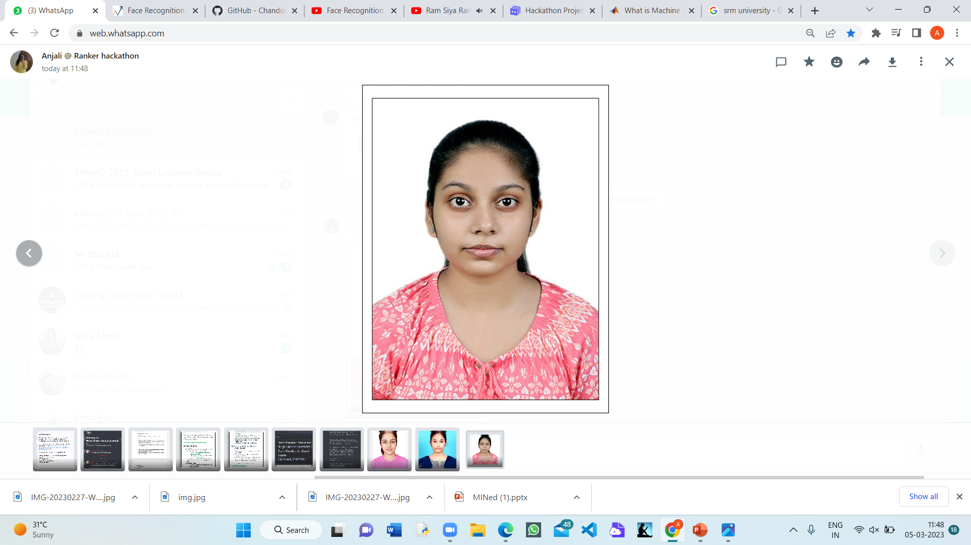

TEAM : RANKER
SRM INSTITUTE OF SCIENCE AND TECHNOLOGY
MEET THE TEAM MEMBERS OF RANKER
Ayushi Agarwal
(Team Leader)
Jhanvi Gupta
Namrata Singh
Anjali Singh
C S Hari Chandana

Slide 3
PROBLEM STATEMENT
Our project deals with the task to identify a human face from a CCTV camera with the help of computer vision. If CCTV camera frame contains multiple faces , then developed model must have capability to recognize all the faces in a frame.
After recognition of faces developed ,Software will return face identity and date and time of recognition in a csv file.

Slide 4
INTRODUCTION
Machine learning is a branch of artificial intelligence and computer science which focuses on the use of data and algorithms to imitate the way that humans learn, gradually improving its accuracy.
Supervised machine learning builds a model that makes predictions based on evidence in the presence of uncertainty.
A supervised learning algorithm takes a known set of input data and known responses to the data (output) and trains a model to generate reasonable predictions for the response to new data.
Our team has made a program regarding Face recognition by using Jupyter notebook. We have imported various libraries like open cv library and os library.
In our project we train the system to recognize the human face of worker so that it can recognize and register it and replicate the same when new data entries are encountered. It then returns the respective worker id and name from sql database.

Slide 5
HACKATHON PROJECT PROPOSAL
The hackathon started from 3rd march and was up to 5th march 2023
Objective : To recognize human face from CCTV camera and return the details like name and id of the user.
1 st set of code : ENTERING AND FEEDING THE NAME AND ID THEN STORING IMAGE ACCORDING TO NAME AND ID
2ND set of code : TRAIN THE MODEL USING THE SAVED DATA.
AFTER TRAINING WE HAVE RUN TEST CASES
Outcome : SAVED DATA AND LIVE VIDEO MATCHES SUCCESSFULLY

Slide 6
WHY SHOULD ONE CHOOSE OUR SOLUTION?
We have unique solution to the problem of face recognition of human
We can train the system for ‘N’ no. of people to register , save and recognize new inputs successfully.

Slide 7
LIMITATIONS
Time of face recognition could not be given.
Data set had access denied so data could not be extracted from it, we gave our own live video training.

Slide 8
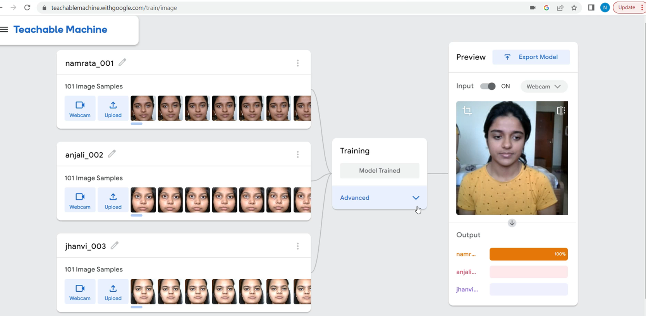
SCREENSHOT/DEMO VIDEO

Slide 9
REFERNCES
https://youtube.com/watch?v=lH01BgsIPuE&si=EnSIkaIECMiOmarE
https://www.analyticsvidhya.com/blog/2021/06/learn-how-to-implement-face-recognition-using-opencv-with-python/

